Slide 1


Principles of Computing
Presentation by
Lyernisha S R

Slide 2
Functions

Slide 3
Function
Let X and Y be sets.
A function f from X to Y , is a relation that assigns each y-value with only one x-value.
The standard notation f : X →Y is used to denote a function f from set X to set Y.

Slide 4
Representation of Functions
•Approach 1: explicitly state the assignment by the form f(x)for every x in the domain.
A function 𝑓:𝑋→𝐍 with 𝑋={1,2,3,4} given by
𝑓(1)=39,𝑓(2)=40,𝑓(3)=39,𝑓(4)=36
•Approach 2: explicitly express the assignment as a set of ordered pairs, which is called the graph of the function, defined as 𝐹=𝑥,𝑦∈𝑋×𝑌𝑓(𝑥=𝑦}
𝐹={(1,39),(2,40),(3,39),(4,36)}
•Approach 3: provide the general relation between x and f(x).
𝑓:𝑋→N with 𝑋={1,2,3,4}given by 𝑓(𝑥)=40−(𝑥−2)²

Slide 5
Domain and Codomain
Let X and Y be sets and let f be a function from X to Y, that is, f : X → Y , then
the set X is called the domain of the function,
the set Y is called the codomain(range) of the function.

Slide 6


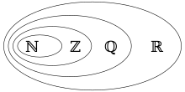
Image of a Function
Image
Let X and Y be sets and consider a function f : X → Y .
Let a ∈ X, and let b = f (a), then:
b is called the image of a, and
a is called the pre-image of b.
Image-set
The image-set of f is the set of all images of the domain of f . The image-set of f is denoted by Image( f )
Example
Let X = { 1, 2, 3, 4, 5, 6 }. Consider the function f defined by
Then the image-set of f is Image( f ) = { 3,6,9,12,15,18}
Consider a function f :R→Q given by f (x) = the integer part of x.
Image set = {…-3,-2,-1,0,1,2,3,…}=Z

Slide 7
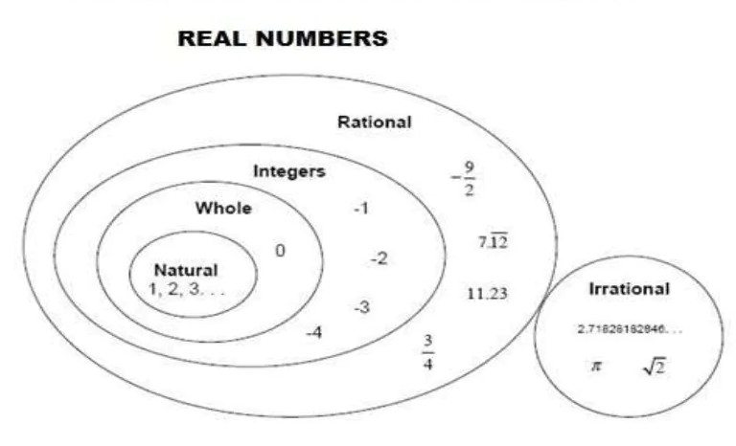
Number system

Slide 8
Arity of a Function
The arity of a function is the number of formal arguments it takes.
–Unary, binary and ternary
Examples of some standard numerical functions
–int: R →Z ‘integer part of’ int(14.56)=14
–nint: R →Z ‘nearest integer’ nint(14.56) = 15
–floor: R →Z ‘floor function’ floor(-14.1) = -15/floor(14.1) = 14
–ceiling: R →Z ‘ceiling function’ ceiling(-14.1) = -14/ ceiling(14.1) = 15
–mod: ZxN→Z ‘modulo function’ mod(20,6) = 2
–div: ZxN→Z ‘integer part of division’ div(20,6) = 3

Slide 9
Composition of Two Functions
In most programming languages it is possible to place the output of a function as an input of another function.
intoutput = floor(sqrt(123.24))
A function that combines two functions in that the output of one of the functions feeds as the input of another function is referred to as the composition of functions. The composition of two functions is itself a function.
Consider the two function 𝑓: 𝐴→𝐵 and 𝑔: 𝐶→𝐷 with the condition that 𝐵⊆𝐶, then the composition of fand g is denoted as 𝑔∘𝑓(𝑥)=𝑔(𝑓(𝑥))

Slide 10
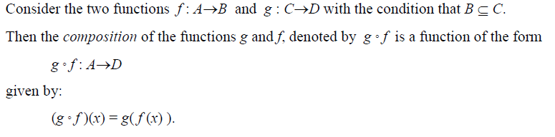
Composition of Two Functions
Notice that
The domain of gof is the domain of f.
The codomain of gof is the codomain of g.
Consider the following two functions:
𝑓:𝑵×𝑵→𝒁, given by 𝑓(𝑚,𝑛)=𝑚−𝑛
𝑔:𝒁→𝑵,given by 𝑔(𝑝)=2+𝑝⁴
Calculate (𝑔∘𝑓)(4,6).
g(f(4,6))=g(4-6)
g(-2)=2+(-2)⁴
=2+16=18

Slide 11
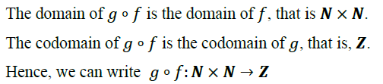
(b)Consider the following two functions: f: N × N → R, given by f(m,n)=n³÷m g: R→ Z, given by 𝑔(𝑝) = 2 + (3 ×p)
(i) State the domain and co domain of the function g ₒ f.
(ii) Calculate (g ₒ f)(4, 2)
answer= 8

Slide 12
Try to find!
f(x) = 3x + 2 and g(x) = 2x + 5.
Find f ∘ g (5).
A. 19
B. 39
C. 47

Slide 13
Try to find!
f(x) = 2x – 4 and g(x) = 2x + 8.
Find g ∘ f( x).
A. 4x
B. 4x+4
C. 2x+4

Slide 14

Injection
A function is said to be an injection (one-to-one)if and only if the function maps distinctmembers of the domain to distinctmembers of the codomain.
𝑥₁≠𝑥₂ ⟹ 𝑓(𝑥₁ ) ≠𝑓(𝑥₂)
𝑓(𝑥₁ ) =𝑓(𝑥₂) ⟹ 𝑥1=𝑥₂
E.g., 𝑓:𝐍→𝐍, given by 𝑓(𝑥) =𝑥²
𝑓:𝐙→𝐙, given by 𝑓(𝑥) =𝑥²

Slide 15
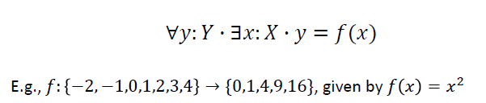
Surjection
A function is said to be a surjection (onto)if and only if its image-set is equal to its codomain. In other words, a surjection is a function in which every element in the codomain is the image of at least one element in the domain.

Slide 16
Bijection
It is
| Domain | = | Codomain |
It is also known as a one-to-one and onto function.

Slide 17
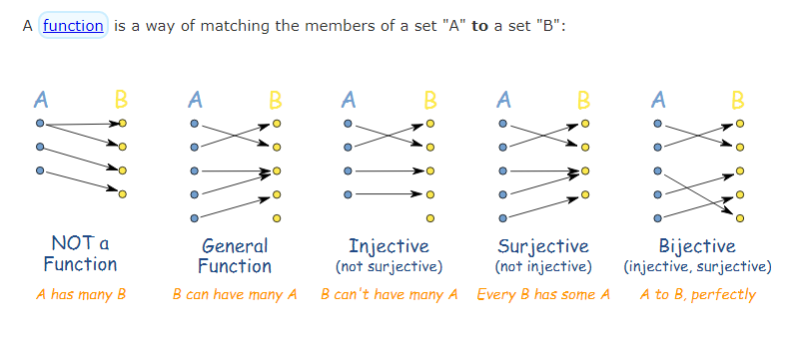
Functions with Different Properties

Slide 18
Suppose A={1,2,3}, and B={r,s,t,u,v} and
f(1) = s g(1) = r
f(2) = t g(2) = t
f(3) = r g(3) = r
A. f and g are injective
B. f is injective and g is not
C. f is not injective and g is
D. neither f and g is injective

Slide 19
Exercise
For each of the following functions, determine whether
they are an injection, a surjection or a bijection.
(i) f : {-2, -1, 0, 1, 2, 3, 4} → { 0, 1, 4, 9, 16 }, given by f (x) = x²
(ii) f : N→ N given by f (n) = 4n.
(iii) f : N→ N given by f (n) = n-(-1)^{n}.
SURJECTION
BIJECTION
BIJECTION

Slide 20
Example
Consider these functions from the set of students in a discrete mathematics class. Under what conditions is the function one-to-one if it assigns to a student his or her
a) mobile phone number.
b) student identification number.
c) final grade in the class.
d) home town.

Slide 21
Inverse Function
If a function is bijective, the function has an inverse function.
Let 𝑓:𝑋→𝑌 be a bijection. Then the function 𝑔:𝑌→𝑋 such that 𝑔(𝑦)=𝑥 where 𝑦=𝑓(𝑥) is called the inverse of f

Slide 22
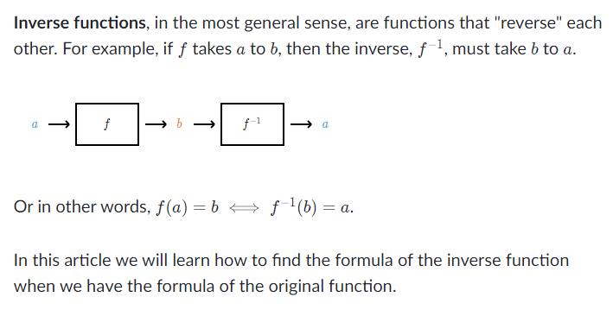

Slide 23

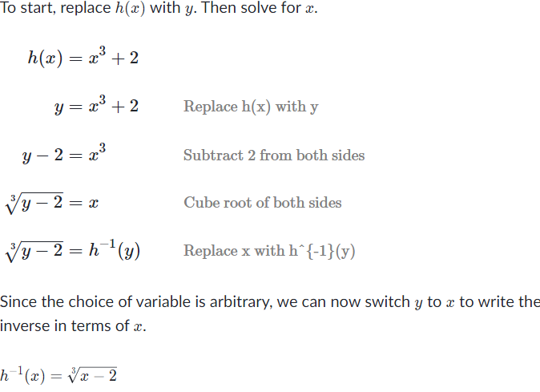

Slide 24
Summary
Function
Composition
Injection
Surjection
Bijection
Inverse

Slide 25
Thank you!

